Slide 1
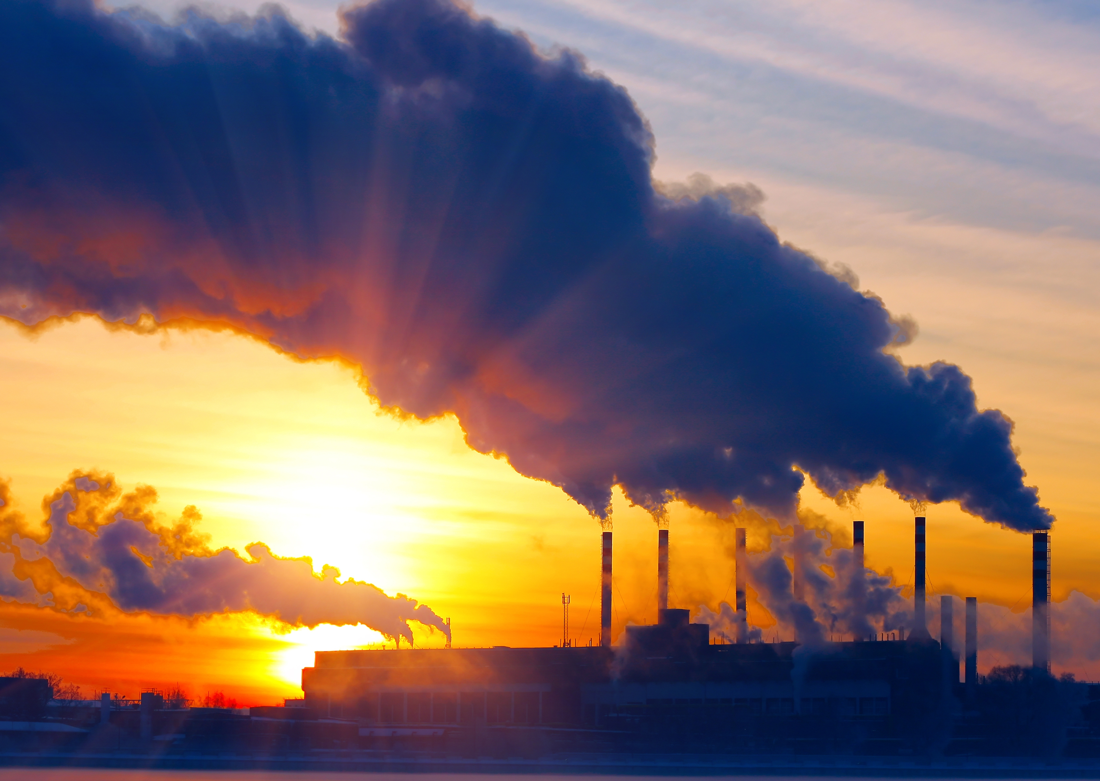
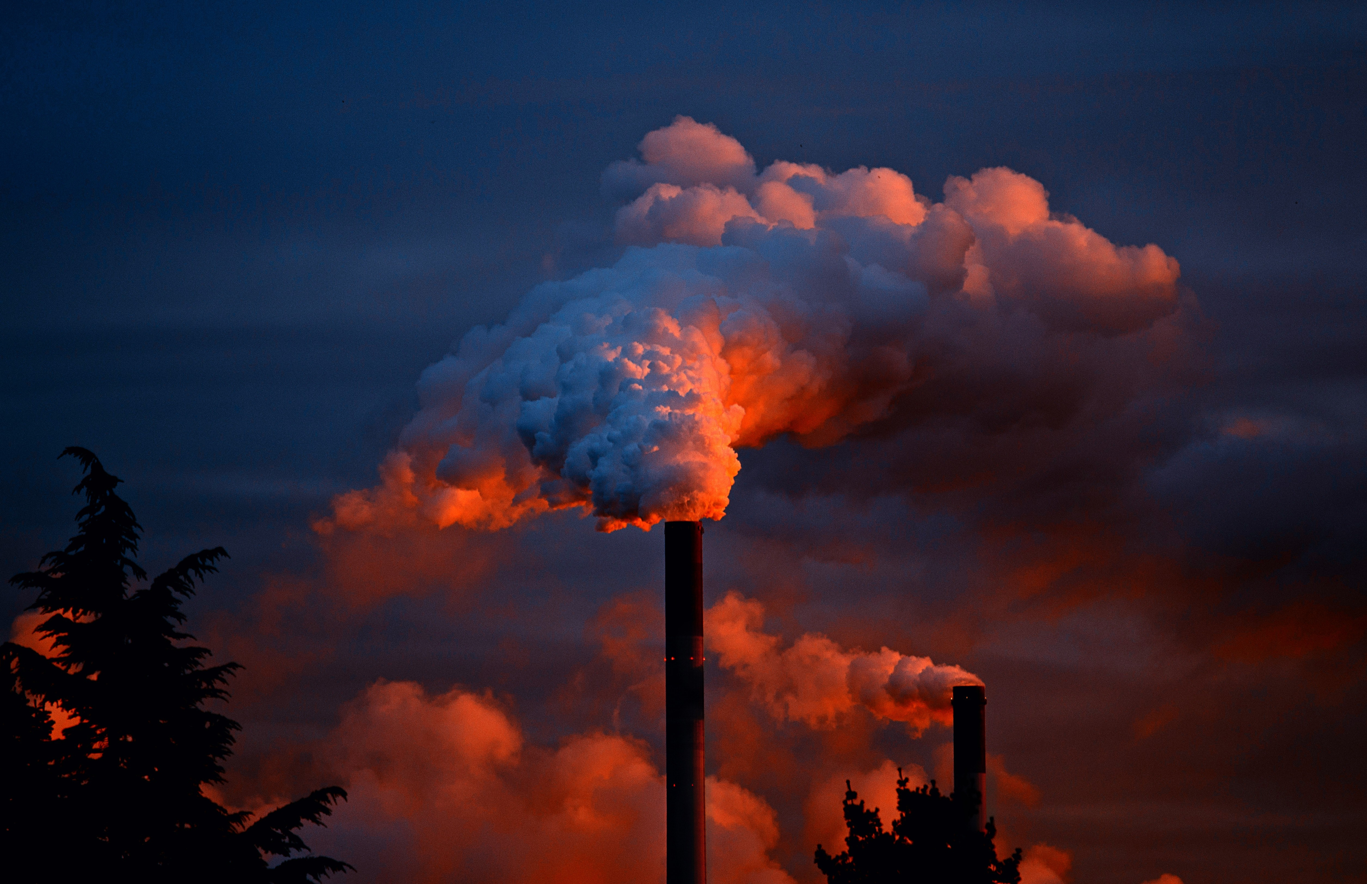

AIR QUALITY ANALYSIS IN TAMILNADU
Presented by,
M.YUKESHWARI
M.KALAIYARASI
M.ABIRAMI
T.SHIVARANJANI

Slide 2
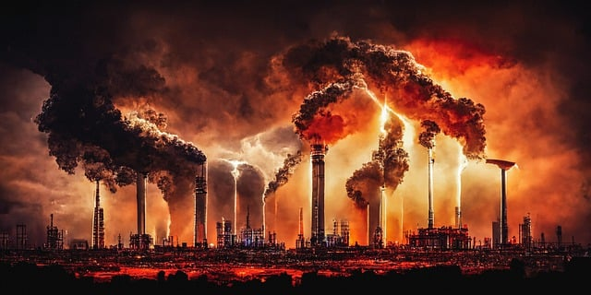
OBJECTIVES
1)DATA COLLECTION
2)DATA IMPORTING
3)DATA ANALYZING
4)DATA PREPROCESSING
5)DATA VISUALIZATION

Slide 3
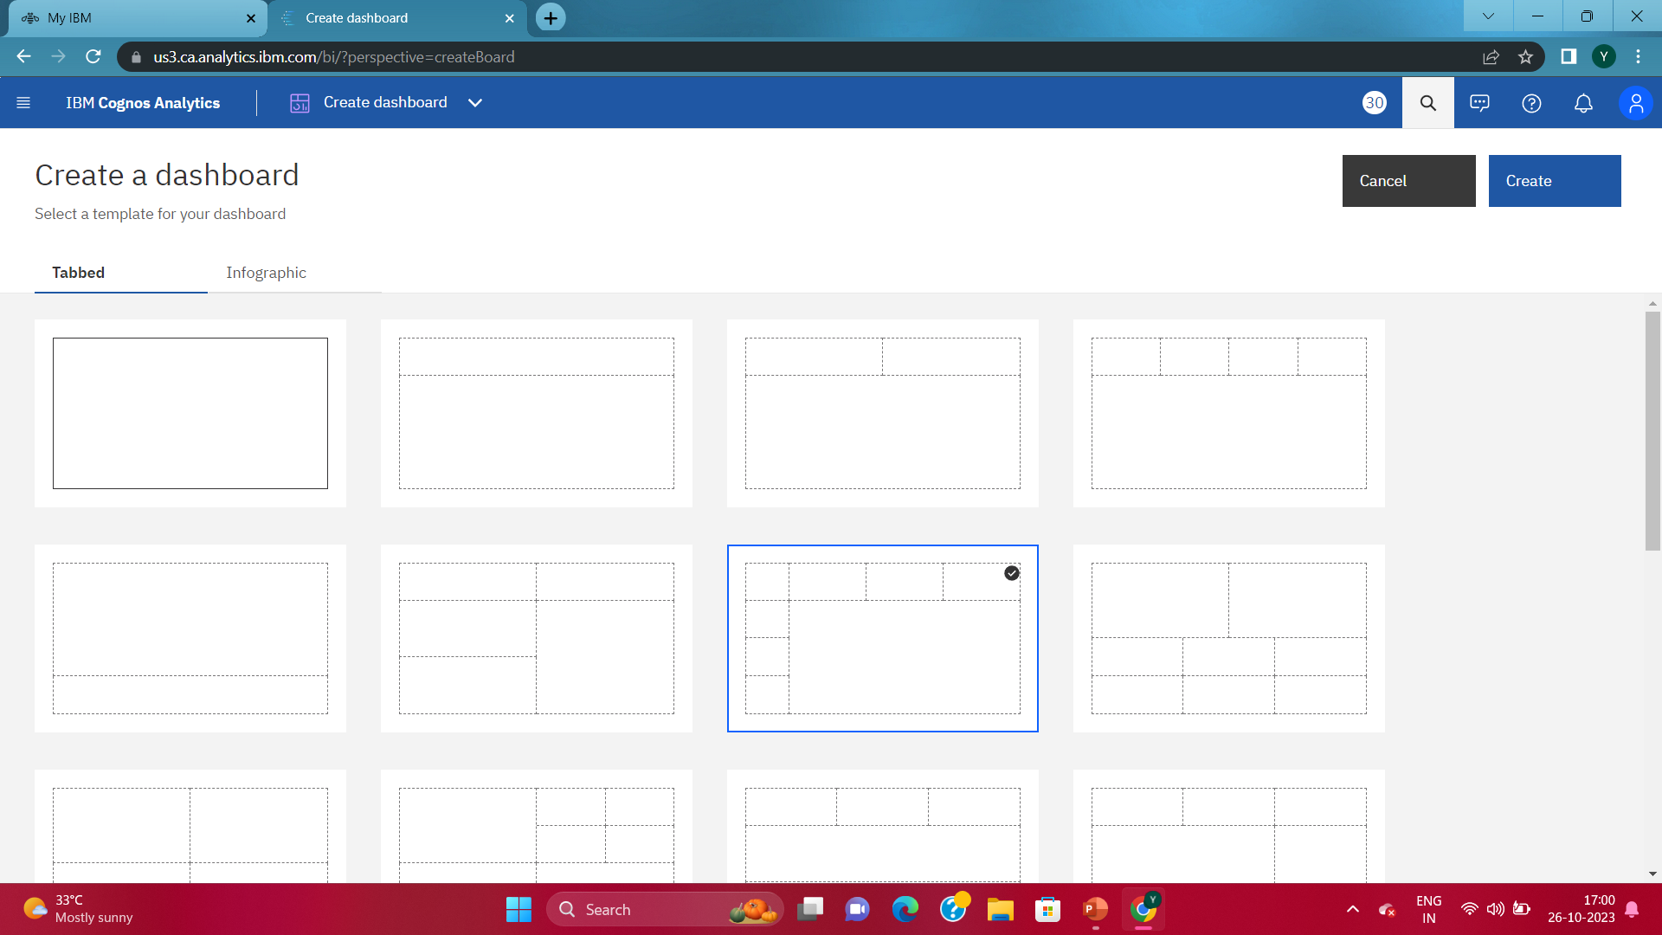
Step-1:Downloading and uploading the dataset
THE FOLLOWING DATASET IS DOWNLOADED AND IT IS SAVED IN FILE MANAGER AND IT IS UPLOADED

Slide 4
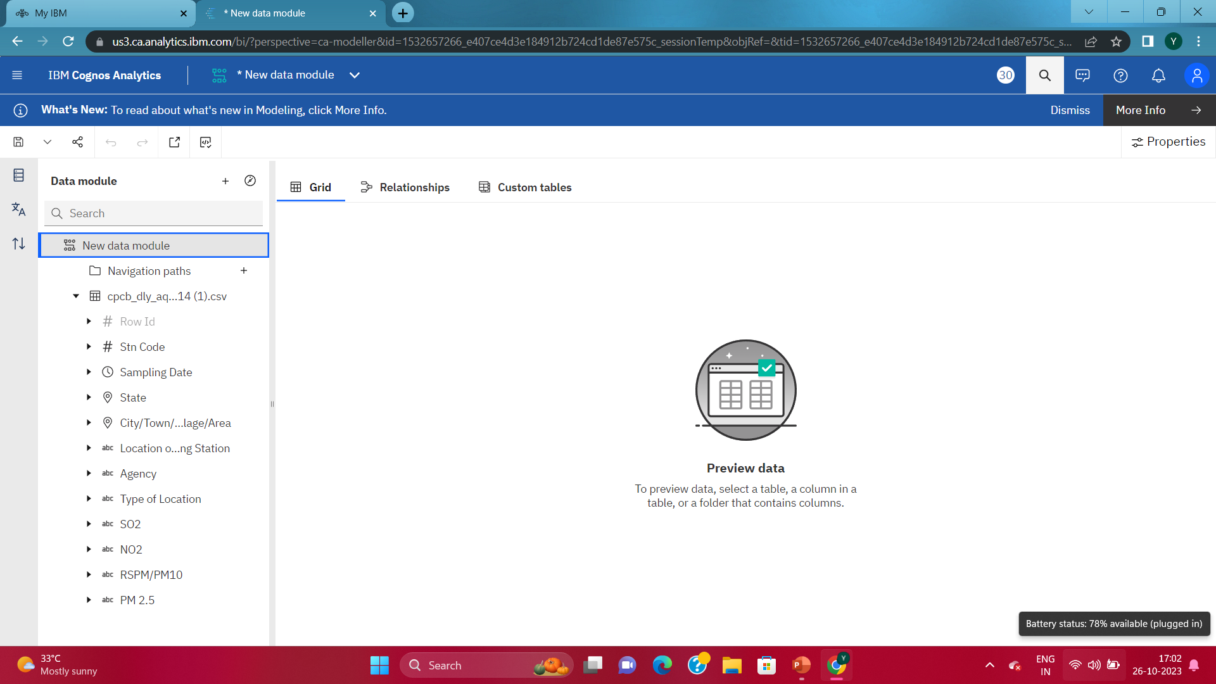
Step-2:Data collection and analysis
IN THIS STAGE ,DATA IS COLLECTED AND ANALYSED USING IBM COGNOS ANALYTICS SOFTWARE

Slide 5
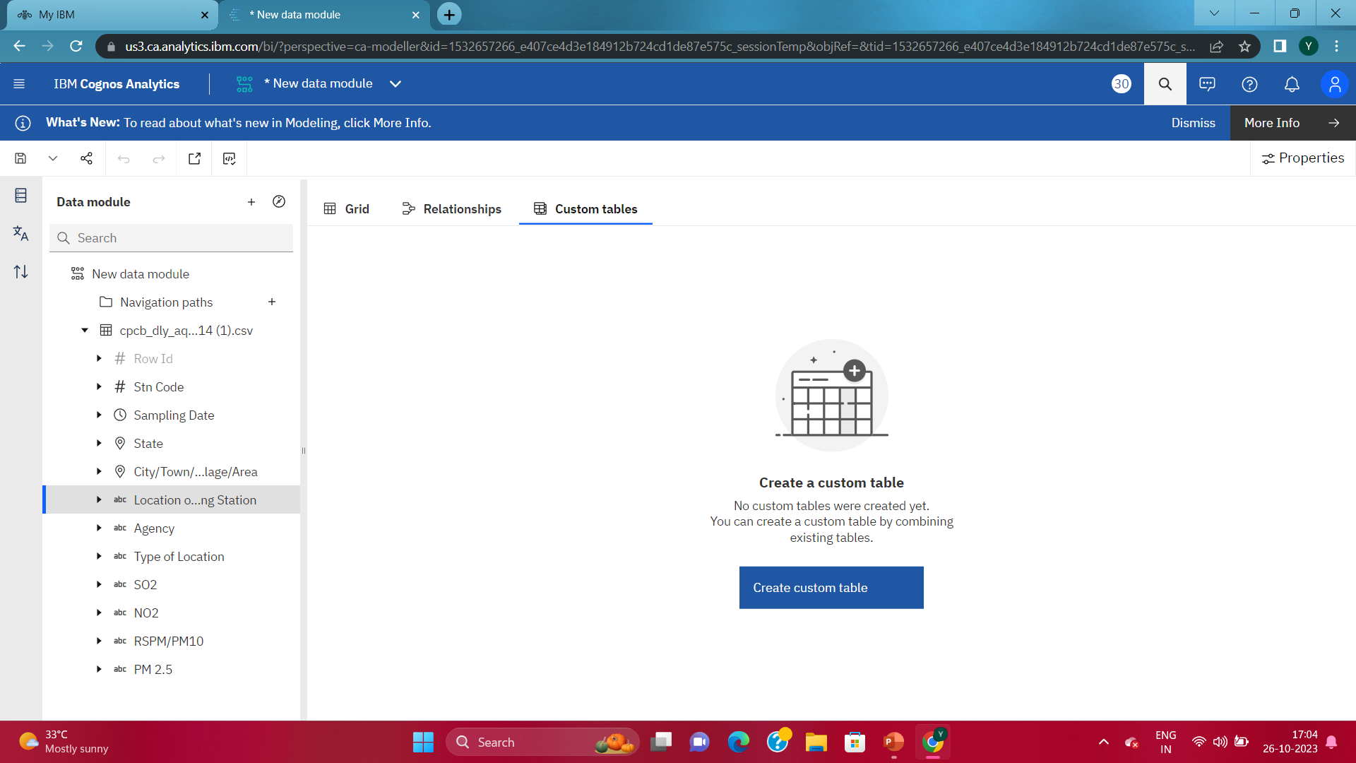
Step-3:Data preprocessing and cleaning

Slide 6
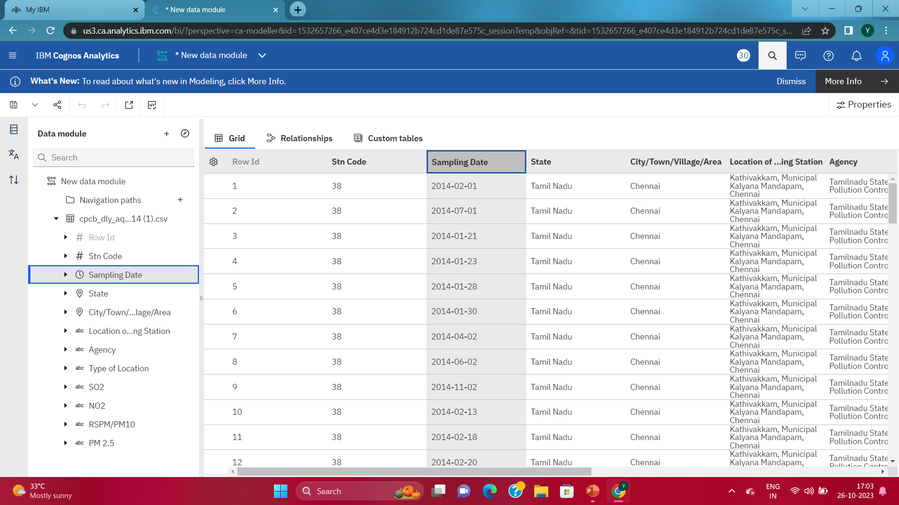

Slide 7
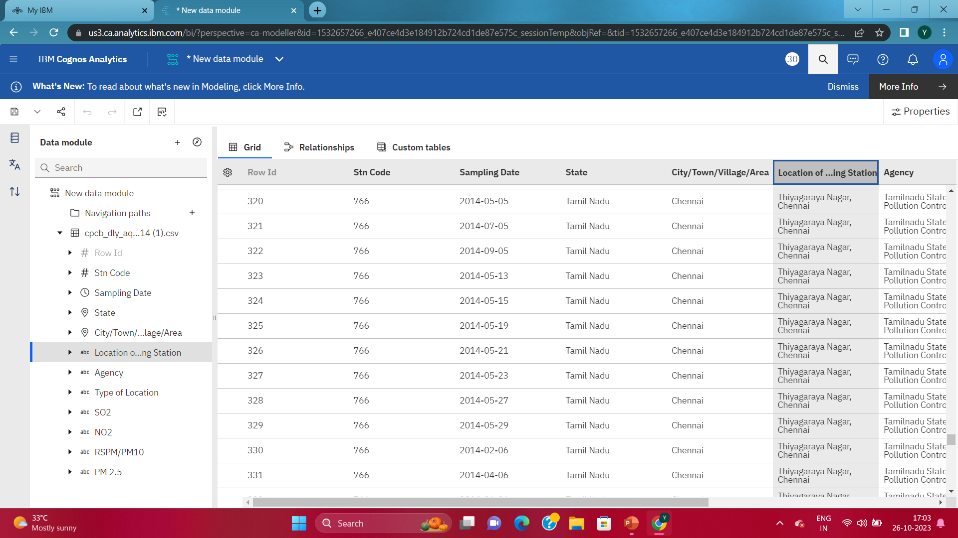

Slide 8
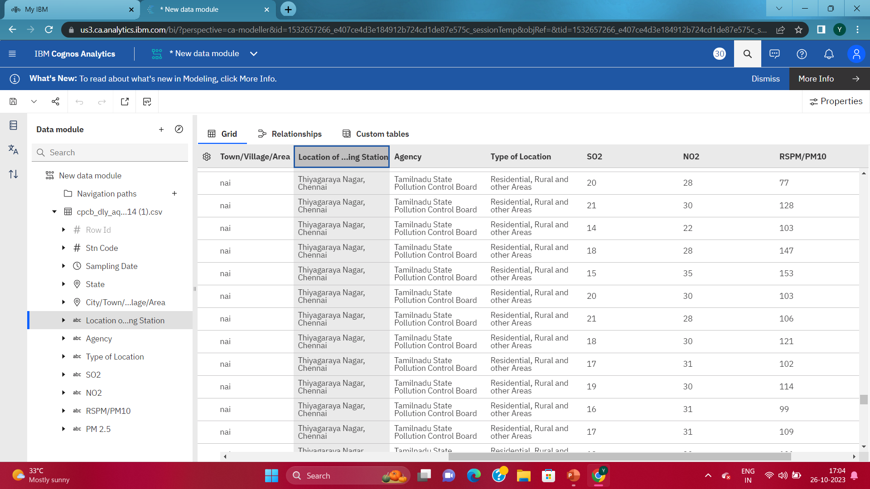

Slide 10
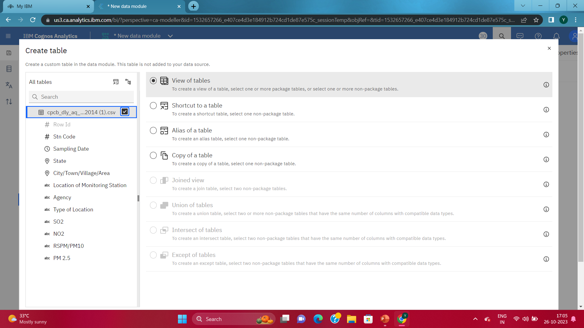

Slide 11
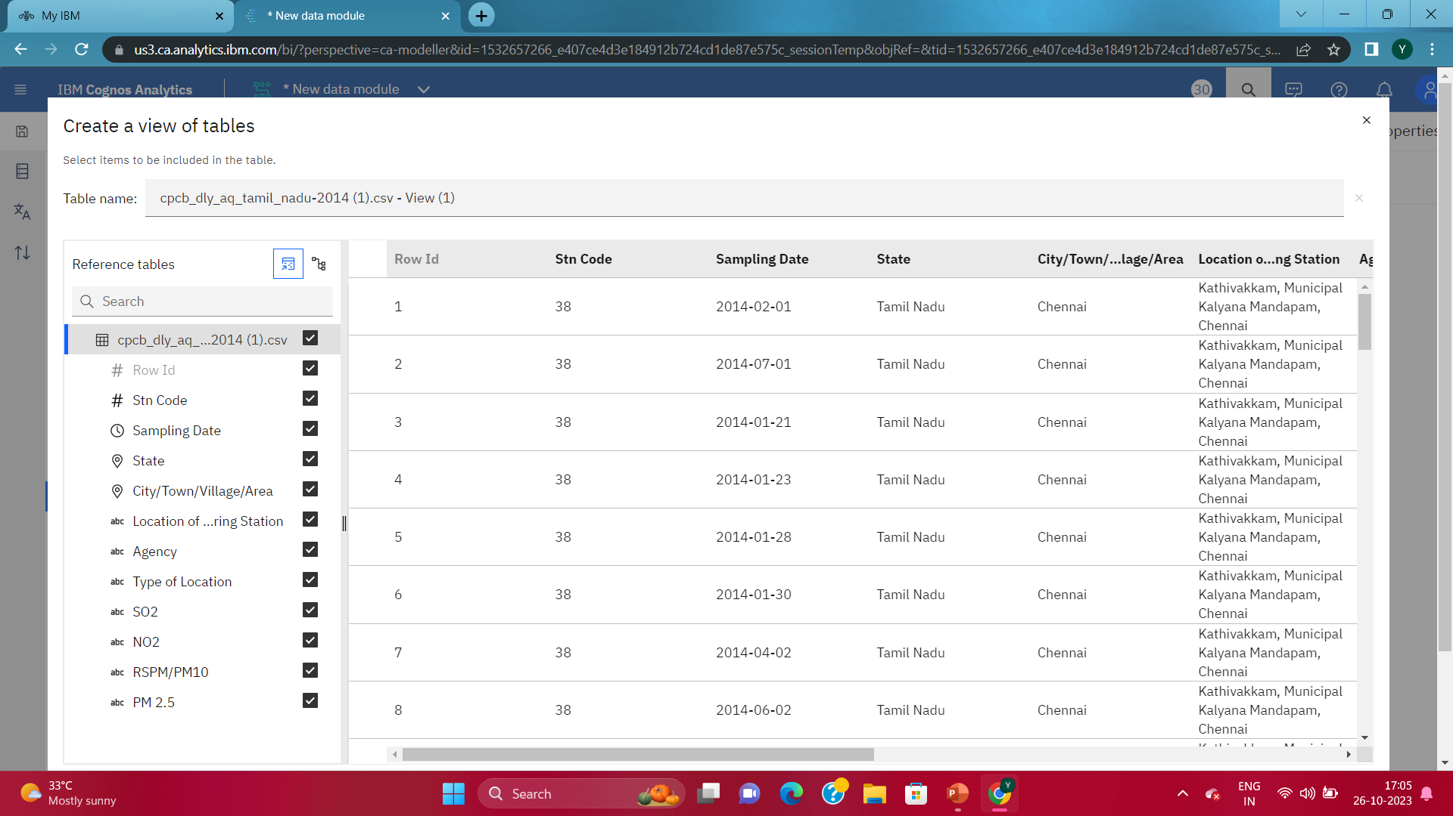

Slide 12
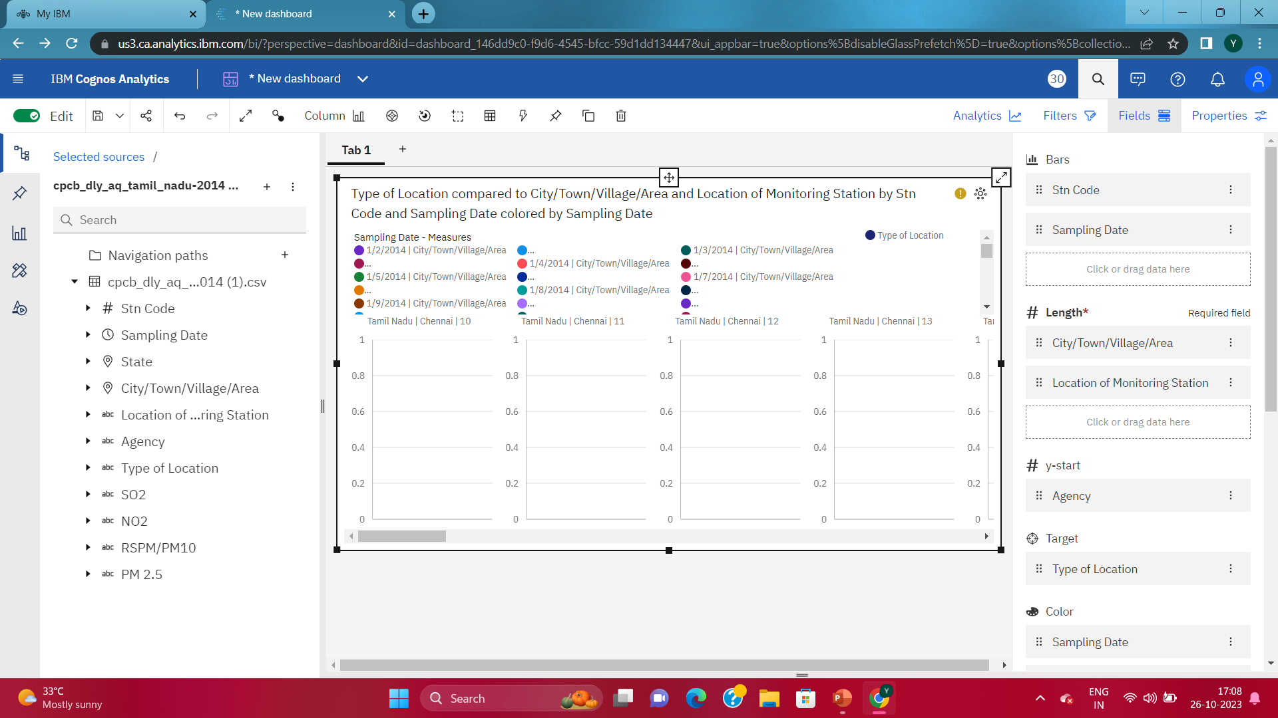

Slide 13
THANK YOU

